Slide 1
Integrating EMDR Into Couples Therapy: Enhancing Relationships Through Trauma-Informed Practices
Exploring EMDR's role in improving couple dynamics
Notes:
---
This presentation explores how Eye Movement Desensitization and Reprocessing (EMDR) can be effectively integrated into couples therapy. We will discuss the historical context, benefits, and challenges of this approach, as well as specific treatment methods and relevant case studies.

Slide 2
Session Outline
Introduction
Historical Background
Benefits of Integration
Theoretical and Methodological Challenges
Assessment and Contracting
Treatment Considerations
Notes:
In this session, we will first introduce EMDR and couples therapy, emphasizing the significance of their integration. We will then look at the historical background of this integration, followed by the benefits it offers couples. Additionally, we will discuss challenges faced in practice before outlining assessment methods and treatment approaches, concluding with case studies.

Slide 3
Introduction: EMDR and Couples Therapy
1996 2001 2007
1996: Snyder publishes the earliest work on EMDR therapy.
2001: Protinsky et al. integrate EMDR with Emotionally Focused Therapy (EFT).
2007: Talan investigates EMDR in Imago therapy.
2007: Authors such as Errebo & Sommers-Flanagan (2007), Knox (2016), Linder (2022), and Moses (2007) have described using EMDR with EFT.
2007: Litt introduces ego-state informed Contextual Therapy.
Notes:
We begin by providing a foundational understanding of EMDR and couples therapy. This will set the stage for discussing how trauma-informed practices can enhance relational dynamics.

Slide 4
Importance of Integrating EMDR
Into Couples Therapy
Understanding Trauma's Impact
Couples learn how individual traumas influence their relationship dynamics, fostering deeper insights.
Reduced Reactivity
Partners experience less through trauma processing and emotional regulation.
Strengthening Attachment
The approach enhances secure attachment patterns by addressing traumatic residues that hinder healthy bonding and trust formation.
Litt, 2024
Notes:
Integrating EMDR into couples therapy allows for a deeper understanding of how individual traumas affect relational dynamics. This trauma-informed approach can lead to enhanced empathy, improved communication, and stronger emotional bonds between partners.

Slide 5
Challenges and Considerations
Epistemological: systemic vs linear causality
Modal: individual, couples, family, or group therapy
Countertransference: activation of the therapist’s implicit relational templates
Notes:
While the integration of EMDR into couples therapy is beneficial, it presents several challenges. This section discusses what therapists need to consider when implementing this approach.

Slide 6
Epistemological Challenges: History
In the 1960s, the emerging field of family therapy gave rise to couples therapy as we know it today (Litt, 2007).
Anchored in the paradigm of general system theory (Bertalanffy, 1950), the family therapy movement regarded individual behavior and experience as structurally determined by the complex relational system in which they were embedded.
The locus of assessment and intervention was the system of relationships—not the individual.

Slide 7
Epistemological Challenges: Contemporary
Modern systems-oriented therapists are more willing to consider family members' motivations, personality, and attachment needs and integrate interventions drawn from individual psychotherapy (Kaslow, 2009).
Systemic purists may be hobbled if they restrict their assessment and interventions to the unit of the “couple” as its own anthropomorphic agent (Boszormenyi-Nagy & Krasner, 1986; Litt, 2007).

Slide 8
Epistemological Challenges: Practices
This legacy of systemic determinism includes couples therapy practices that neutralize each partner's needs, behavior, or responsibility:
  Non-blaming stance: problems belong to “the couple”
  Equal talk time
  Equal number of individual sessions for each partner
  “Balancing”: each partner spends equal amounts of time in the “hot seat”

Slide 9
Epistemological Challenges: Practices
  Offering phase 4 to both partners simultaneously
  Prescribing phase 4 to both partners for the sake of “balance” instead of individual needs and goals
  Avoiding individual assessment or diagnosis
  Accepting obfuscating presenting problems at face value: “We want to improve communication.”

Slide 10
Epistemological Challenges: Negative effects
In these tortured efforts to avoid taking sides (and thereby assigning the “bad object” role), individual responsibility is forfeited, and problems are externalized.
Instead, they are attributed to a blameless, abstract entity: “The relationship did it!”
Anyone who runs a household knows that we don’t take out the trash; only one of us does.
Seeking a relational solution to a psychological problem

Slide 11
Modal Challenges
Modes of treatment include individual, couples, family, and group therapy.
Each mode is its own discipline with distinct theories and methods.
Therapists may conflate modes of therapy with the number of clients in the session.
In an integrated, systemically informed EMDR therapy approach, everyone is considered a client.
Notes:
Integrating EMDR with couples therapy requires therapists to navigate the complexities of combining individual-focused and relationship-focused modalities. Understanding these modal challenges is essential for effective practice.

Slide 12
Modal Challenges
YES—you can see partners individually and conjointly!
Session attendance is tactical and goal-oriented for specific individuals and sessions.
Conjoint sessions are indicated for repairing ruptures, delineating boundaries, facilitating personal responsibility, teaching skills, or aligning relationship goals.
EMDR can be used individually or in conjoint sessions.
Notes:
Integrating EMDR with couples therapy requires therapists to navigate the complexities of combining individual-focused and relationship-focused modalities. Understanding these modal challenges is essential for effective practice.

Slide 13
Countertransference Challenges: Therapist’s history:
Parentification (Boszormenyi-Nagy, 1965)
  Peacemaker role/Mediator/Referee
  Subordinates own needs to comfort the parent(s)
Split loyalty (Boszormenyi-Nagy & Krasner, 1986, p.421)
  Loyalty to one is disloyal to the other
  double-bind: A no-win predicament
  Adults cannot be trusted
  intense internal conflict, and the internalized sense of failure
Notes:
Countertransference can arise when therapists project their own experiences onto clients. Being aware of these issues is vital to maintain a therapeutic environment that supports both individuals and the couple.

Slide 14
Countertransference Challenges: Therapist’s history of:
Abandonment trauma
  Fighting parents may overlook their anxious and bewildered children.
Pseudomutuality (Wynne et al., 1958)
  Family members feign unity by hiding or dissociating their conflicts.
  From rupture to “harmony”: No REPAIR
  Conflict elicits intense negative feelings.
  Capitulating versus trusting: self-trust is undermined.
Notes:
Countertransference can arise when therapists project their own experiences onto clients. Being aware of these issues is vital to maintain a therapeutic environment that supports both individuals and the couple.

Slide 15
Countertransference Issues: Hidden Traps
Therapists with this background can be retraumatized by conflicting couples.
They may rely on unconscious relational patterning when dealing with couples.
The therapist's desire to avoid worsening conflict between their own parents may be unconsciously transferred to the clients.
Notes:
Countertransference can arise when therapists project their own experiences onto clients. Being aware of these issues is vital to maintain a therapeutic environment that supports both individuals and the couple.

Slide 16
Countertransference Issues: Manifestations
Stance of therapeutic neutrality: “both sides are good”
Externalizing issues: “It’s the economy/job stress/etc!”
Reframing behaviors for positive intent
Prematurely seeking harmony or pseudo-reconciliation.
These interventions are enshrined in various models of couples therapy, where clinicians may seek refuge to manage re-traumatization.
Notes:
Countertransference can arise when therapists project their own experiences onto clients. Being aware of these issues is vital to maintain a therapeutic environment that supports both individuals and the couple.

Slide 17
Countertransference Issues: Missed Opportunities
Personal accountability is forfeit
Trauma history is off limits
Reinforcement of the “bad object”
Recursive pathological cycles/reenactments remain entrenched
Notes:
Countertransference can arise when therapists project their own experiences onto clients. Being aware of these issues is vital to maintain a therapeutic environment that supports both individuals and the couple.

Slide 18
Assessment Framework
Horizontal and Vertical Dimensions
Horizontal Assessment
Pathological recursive patterns
Boundary violations: physical, verbal, emotional
Power dynamics; manipulation; deception
Lack of shared narrative
Dysfunctional communication strategies
Notes:
Effective assessment and contracting are key components of EMDR-based couples therapy. This section outlines methods to ensure that both individual and conjoint needs are met.

Slide 19
Assessment Framework
Horizontal and Vertical Dimensions
Vertical Assessment
Intersubjective fusion (Boszormenyi-Nagy, 1965)
Pathological dependency (Litt, 2024)
Notes:
Effective assessment and contracting are key components of EMDR-based couples therapy. This section outlines methods to ensure that both individual and conjoint needs are met.

Slide 20
Intersubjective Fusion
Everyone starts out “fused” or symbiotically attached to the primary caregiver
Separation and individuation are stalled
Nobody is perfect: everybody has some degree of fusion
Independent of enmeshment or disengagement
Notes:
Effective assessment and contracting are key components of EMDR-based couples therapy. This section outlines methods to ensure that both individual and conjoint needs are met.

Slide 21
Intersubjective Fusion
Partners have diffuse ego boundaries and merge their thoughts, feelings, and needs to create a unified personality (Boszormenyi-Nagy, 1965).
Sounds like romantic love ("two of us become one"), but it is a form of pathological dependency.
This symbiosis compromises autonomy and hinders the development of genuine options for building trust and intimacy.
Failures in empathy, mentalization, compassion, mutuality, and self-regulation stem from patterned, internalized relational trauma and consequent personality adaptation.
Notes:
Effective assessment and contracting are key components of EMDR-based couples therapy. This section outlines methods to ensure that both individual and conjoint needs are met.

Slide 22
Pathological Dependency (Litt, 2007)
An affinity displacing autonomous ego functions onto partners (Litt, 2007, p. 12 )
Manifestations of fusion—what to look for:
Notes:
Effective assessment and contracting are key components of EMDR-based couples therapy. This section outlines methods to ensure that both individual and conjoint needs are met.

Slide 23
Merger: When two become One
SUPEREGO
SUPEREGO
ego
ego
id
id

Slide 24
Pathological Dependency
Ego, id, and superego functions: Shared or distributed between partners, leading to a symbiotic, parent-child dynamic (Framo, 1982).
Constant object function: Depending on the continuous presence of the partner to combat traumatic aloneness
The soothing function: Expecting that soothing can only come from the partner, an entitlement to be infantilized
Self-validation function: Seeking caregiver approval is transferred to intimate partners, leading to parentification (Kernberg, 1980).
Notes:
Effective assessment and contracting are key components of EMDR-based couples therapy. This section outlines methods to ensure that both individual and conjoint needs are met.

Slide 25
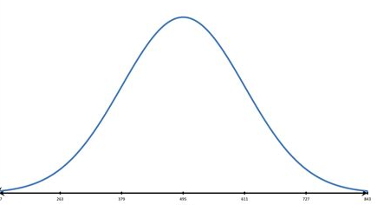
Pathological Dependency:
The Bad Object Game (Litt, 2024)
Infant consciousness rests on two opposing “tectonic plates”:
  Pleasure: Good object/subject
  Pain: Bad object/subject
Healthy development involves integrating these two states, or transcending them
Nobody is perfect: probably a bell curve
Notes:
Effective assessment and contracting are key components of EMDR-based couples therapy. This section outlines methods to ensure that both individual and conjoint needs are met.

Slide 26
Pathological Dependency:
The Bad Object Game (Litt, 2024)
Negative Emotion (pain) evokes “Badness”
“Badness” must be internalized (subject) or externalized (object)
Close attachment relationships are tribunals in which badness is assigned
Notes:
Effective assessment and contracting are key components of EMDR-based couples therapy. This section outlines methods to ensure that both individual and conjoint needs are met.

Slide 27
Pathological Dependency:
The Bad Object Game (Litt, 2024)
Relational dynamics dominated by blame
Judgements—positive and negative—abound
External locus of control: feelings, self-worth, and agency originate in the partner (Litt, 2024)
Notes:
Effective assessment and contracting are key components of EMDR-based couples therapy. This section outlines methods to ensure that both individual and conjoint needs are met.

Slide 28
Strategies for bad object-role assignment:
  Turn-taking: One partner accepts the bad object-role for stability (Boszormenyi-Nagy, 1965)
  Competition: Partners compete over bad object role assignments
  Proportional badness: Couples reduce conflict by accepting some badness
  Triangulation: Partners unite by assigning badness to a third party
Notes:
Effective assessment and contracting are key components of EMDR-based couples therapy. This section outlines methods to ensure that both individual and conjoint needs are met.

Slide 29
Blame/Fault vs. Responsibility
Blame & fault are anchored in badness
  Badness is to be avoided
  Conflicts are adversarial and prosecutorial
  Win/Lose configuration is consolidated based on “proportional fault.”
Responsibility is dialogic & prosocial
  Anchored in mutual acceptance: I’m ok; you’re ok
  Opportunities to grow, care, and help

Slide 30
5-Step Method for
Assessment and Contracting (Litt, 2009)
Identify patterns of pathological dependency
Isolate sensation, emotion, and cognition (phase 3) with one partner*
Contextualize activation (e.g., the convincer; floatback)
Contract for behavior change
Contract for individualized EMDR therapy
Notes:
Assessing individual trauma histories and relational dynamics is crucial for tailoring EMDR interventions. Techniques may include structured interviews and questionnaires to gain comprehensive insights into each partner's experiences.

Slide 31
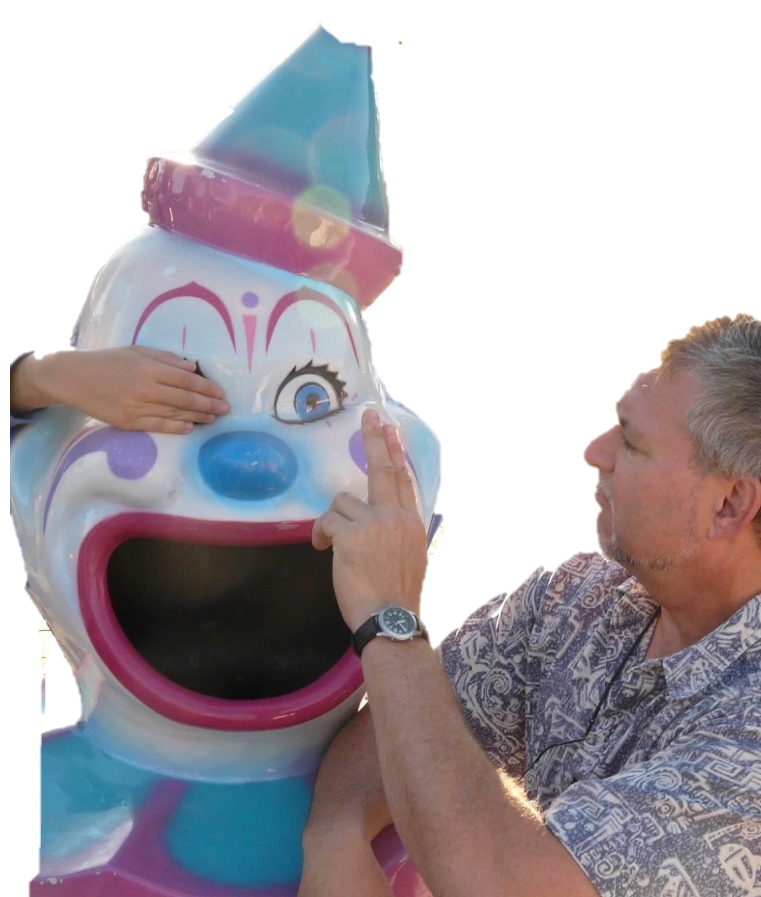
The Convincer
Phase 3, One Eye at a Time
  Ask the client to reflect on contemporaneous interaction:
    – Eyes closed
  Ask the client to check each eye separately:
    – “Cover an eye; stare into space with the other”
  Ascertain the NC from the more activated eye
  Do a floatback (Affect Bridge) with the more activated eye
(Litt, 2024)

Slide 32
Treatment Considerations
Choosing which partner to begin vertical exploration with
Benefits of integrated relational therapy
Contracting for integrated therapy
Conjoint EMDR
Methodological considerations for couples therapy
Notes:
Assessing individual trauma histories and relational dynamics is crucial for tailoring EMDR interventions. Techniques may include structured interviews and questionnaires to gain comprehensive insights into each partner's experiences.

Slide 33
*Choosing Which Partner To Start With
Start with the dominant or more aggressive partner to signal that the therapist is not intimidated and the holding environment is safe for all
Starting with the submissive partner may reinforce their identity as the "sick, bad, or needy" one and mask the dominant partner's trauma and accountability.

Slide 34
*Choosing Which Partner To Start With
Start with the less motivated partner to build their commitment or give them an option to opt out and negotiate a trust-based agreement.
Typically, begin with the most dysregulated partner and then—after they are settled—turn to the second partner for their internal reaction and relational response.

Slide 35
*Choosing Which Partner To Start With
Start with the therapy-naïve partner if the other is well-versed in their vertical issues.
These guidelines are not a substitute for clinical judgment and may conflict in some cases.

Slide 36
Integrated Relational Therapy
One-stop shopping vs referring out
Individual or conjoint sessions based on treatment goals
Multi-lateral accountability
Informed consent; confidentiality protocols
Notes:
Establishing clear agreements on the focus of therapy—whether individual or conjoint—is essential for creating a safe and productive therapeutic environment. This contracting helps manage expectations and goals.

Slide 37
Contracting for Integrated Therapy
Individual or conjoint sessions (e.g., EMDR)
Each partner takes responsibility for the treatment plan: individual and relational work
In client-centered therapy, contracts can be quite fluid
Notes:
Establishing clear agreements on the focus of therapy—whether individual or conjoint—is essential for creating a safe and productive therapeutic environment. This contracting helps manage expectations and goals.

Slide 38
Session Attendance Considerations
Three Pillars of Change:
Getting it
  (Cognitive, psychoeducation; insight)
Feeling it
  (Affective transformation; autonomic resilience)
Doing it
  (Executing new skills)
Individual or Couples Therapy Techniques
Individual or conjoint EMDR Techniques
Couples Therapy Techniques

Slide 39
Conjoint EMDR: Benefits
Projections may be taken back by the working partner.
Therapist models attuned support/dyadic regulation vs rescuing
Therapist models distress tolerance
Building Trust
Participating in conjoint sessions can boost trust, helping partners feel safer and more secure with each other.
Notes:
There are various treatment approaches to integrating EMDR into couples therapy, each with its own strengths. This section highlights effective strategies.

Slide 40
Conjoint EMDR: Contraindications
The working partner cannot emote freely in the partner's presence.
The working partner is not ready to disclose to the partner.
The observing partner will likely use the working partner's revelations in retaliation.
The observing partner is unlikely to tolerate the working partner's affect or disclosures.
The observing partner is unable or unwilling to let the working partner have all the therapist's attention (for example, interrupts the processing with comments or questions). (Litt, 2007, p. 27)
Notes:
There are various treatment approaches to integrating EMDR into couples therapy, each with its own strengths. This section highlights effective strategies.

Slide 41
Conjoint Sessions: Methodological Considerations
The trouble with triangles
Transforming complaints into actionable claims
Serial dialogues
Multi-directed partiality

Slide 42
The Trouble with Triangles
The Drama Triangle (Karpman, 1968)
Rescuer
Victim
Persecutor
Notes:
Real-life examples can provide valuable insights into the integration of EMDR in couples therapy. This section will explore successful cases and the lessons learned.

Slide 43

The Trouble with Triangles
Ganging up
T B
A
Serial Dialogues
T A
A T
T B
Notes:
Real-life examples can provide valuable insights into the integration of EMDR in couples therapy. This section will explore successful cases and the lessons learned.

Slide 44
The Trouble with Triangles
Externalizing Responsibility
T
Other
A:B
Notes:
Real-life examples can provide valuable insights into the integration of EMDR in couples therapy. This section will explore successful cases and the lessons learned.

Slide 45
Converting Complaints Into Claims
Complaints can be invalid, for example:
An attack; blame; judgment
A bid for pathological dependency
  These responses warrant continued exploration
  They should not pass through to the other partner

Slide 46
Converting Complaints Into Claims
Complaints can be valid, for example:
  A bid for empathy, accountability, or behavior change
  Valid claims are actionable; fantasy fulfillment is not
  Promotes differentiation, autonomy, and secure attachment
  These claims are now passed on to the partner

Slide 47
Invalid Claims: a Deeper Look
Demands that promote pathological dependency:
  Demanding the partner to soothe unconditionally and infallibly (Self-soothing function)
  Expecting the partner to make the speaker feel better about him/herself (Self-validation function)
  Wanting the partner to suborn his/her identity to better complement the speaker’s ego (Ego functions; self–validation)
  Expecting the partner to heal the speaker’s attachment wounds (Constant Object function)

Slide 48
Valid Claims: a Deeper Look
Requests of behavior change that:
  Improves boundaries
  Seeks to balance fairness of give and take
    Transactionally, I.e., distribution of resources
    Ethically: balance of Subject/Object Roles
  Promotes earned secure attachment
  Promotes autonomy/differentiation
  Made with conscious intention

Slide 49
The Hearing Test: What does it mean to “Hear”?
To “hear”: I noticed a sound coming from your mouth
To “listen”: I noticed that you were using words
To “HEAR”: to mentalize, empathize, and perspective take*:
  I feel you
  I get what you mean
  I can make your case for you
*whether or not you agree!
Notes:
Real-life examples can provide valuable insights into the integration of EMDR in couples therapy. This section will explore successful cases and the lessons learned.

Slide 50
The Hearing Test
The second partner is asked what they heard of the valid claim
If they interpret, judge, or react defensively, the therapist works to help them:
  Comprehend
  Acknowledge
  Respond responsibly
Notes:
Real-life examples can provide valuable insights into the integration of EMDR in couples therapy. This section will explore successful cases and the lessons learned.

Slide 51
The Hearing Test
If the partner fails the hearing test:
Redirect the client to repeat what was said
Ask if the client wants to know what was said
  If not, why not?
    (Too activated? Destructively entitled?)
Therapist stays with this partner until “hearing” is achieved
Notes:
Real-life examples can provide valuable insights into the integration of EMDR in couples therapy. This section will explore successful cases and the lessons learned.

Slide 52
Multidirected Partiality
(Boszormenyi-Nagy & Krasner, 1986)
Differs from therapeutic neutrality
The therapist is on everybody’s side (partial)—especially children
The therapist empathizes with each side’s valid claim against the other
The therapist holds each party accountable for their effect on the other
Notes:
Real-life examples can provide valuable insights into the integration of EMDR in couples therapy. This section will explore successful cases and the lessons learned.

Slide 53
Conclusion
You can see clients individually and together!
Integrating systemic and individual therapies can be deep, gratifying work for all
Multilateral accountability makes for a solid trust base
Structuring the therapy, especially in the “opening game,” is critical—especially traffic-copping
Seek consultation; read stuff
Notes:
Real-life examples can provide valuable insights into the integration of EMDR in couples therapy. This section will explore successful cases and the lessons learned.

